Slide 1

StessTrack: Student Mental Health Analysis
Presented By : Sanjana Das (CSD24013)
Mayuri Sinha (CSD24002)

Slide 2
Table of contents
01
02
03
04
05
06
Introduction
Objective
Methodologies
Results & Evaluation
Challenges & Future Scope
Conclusions

Slide 3
01
Introduction
Mental health is a critical aspect of overall well-being, especially among students facing academic, social, and personal challenges. This analysis aims to explore factors influencing student mental health using data-driven approaches.

Slide 4
02
Objectives
1. To understand the factors impacting student mental health.
2. To analyze correlations between academic performance and mental health.
3. To provide insights for improving mental health support systems.

Slide 5
About the Dataset
The dataset comprises of 101 records:
Demographics: Timestamp, Gender, age, Course, CGPA, marital status, year of study, Do you have Depression/Anxiety/Panic attack?
Academic factors: Performance metrics.
Social and environmental factors: Data was collected from diverse student populations to ensure a comprehensive analysis.

Slide 6
03
Methodology
Combining Fuzzy C-Means clustering and K-Nearest Neighbors classification to analyze and predict student mental health patterns, identifying high-risk groups and actionable insights.

Slide 7
Our Hybrid Model Structure Consist Of :
Fuzzy C-means (FCM)
We have used Fuzzy C-means for cluster formation. Here, we will group students into clusters based on their mental health characteristics (e.g., levels of depression, anxiety, and panic attacks) and possibly other factors like CGPA and age. Each student is assigned a degree of membership to each cluster, indicating how strongly they belong to potential groups identified by FCM.
K-nearest neighbour (KNN)
Also, we have used KNN(K-nearest neighbour) for the prediction purpose. By utilizing the cluster memberships as features in a KNN model to predict outcomes, such as the likelihood of seeking specialist treatment or the severity of mental health issues. Using the membership values from FCM as input features for KNN, alongside other relevant attributes. This provides a richer feature set that includes both raw data and derived cluster-based insights.

Slide 8
Step 1: Data Preprocessing
Steps taken to prepare the data:
Handled missing values (e.g., imputed missing Age with median).
Encoded categorical variables using Label Encoding and One-Hot Encoding.
Normalized numerical features like Age and CGPA using Min-Max Scaling.
Splitting the data into training and testing sets. ? (70% - training , 30% - testing)

Slide 9
Step 2: Cluster Formation with FCM
Purpose: Group students into clusters based on mental health characteristics (Depression, Anxiety, Panic Attack).
Process:
Selected relevant features for clustering.
Applied FCM to generate soft cluster memberships for each student.
Outcome:
Each student is assigned a degree of membership to clusters (e.g., "High-Stress Group").

Slide 10
Step 3: Prediction with KNN
Purpose: Predict whether a student seeks specialist treatment based on cluster membership and other attributes.
Integration:
Combined cluster membership values with original features for richer predictions.
Used GridSearchCV to find the optimal k value for KNN.

Slide 11
Step 4: Build and Train the KNN model
Choose an appropriate K value using cross-validation.
Train the KNN model to predict your chosen outcome based on the enriched dataset.
Step 5: Evaluate
Use metrics such as accuracy, precision, recall, and F1-score to evaluate the KNN model.

Slide 12
04
Results & Evaluation
Evaluated the performance of KNN models with and without cluster membership using metrics like Accuracy, Precision, Recall, and F1-Score.

Slide 13
Results and Evaluation
Cluster Analysis
KNN model Evaluation
Clusters were ranked based on their "risk levels" calculated from Depression, Anxiety, and Panic Attack scores.
Example:
Cluster 1: High Risk
Cluster 2: Moderate Risk
Cluster 3: Low Risk
With Cluster Membership:
Improved predictions by incorporating cluster-based insights.
Without Cluster Membership:
Lower performance, highlighting the value of clustering in enriching the dataset.

Slide 14
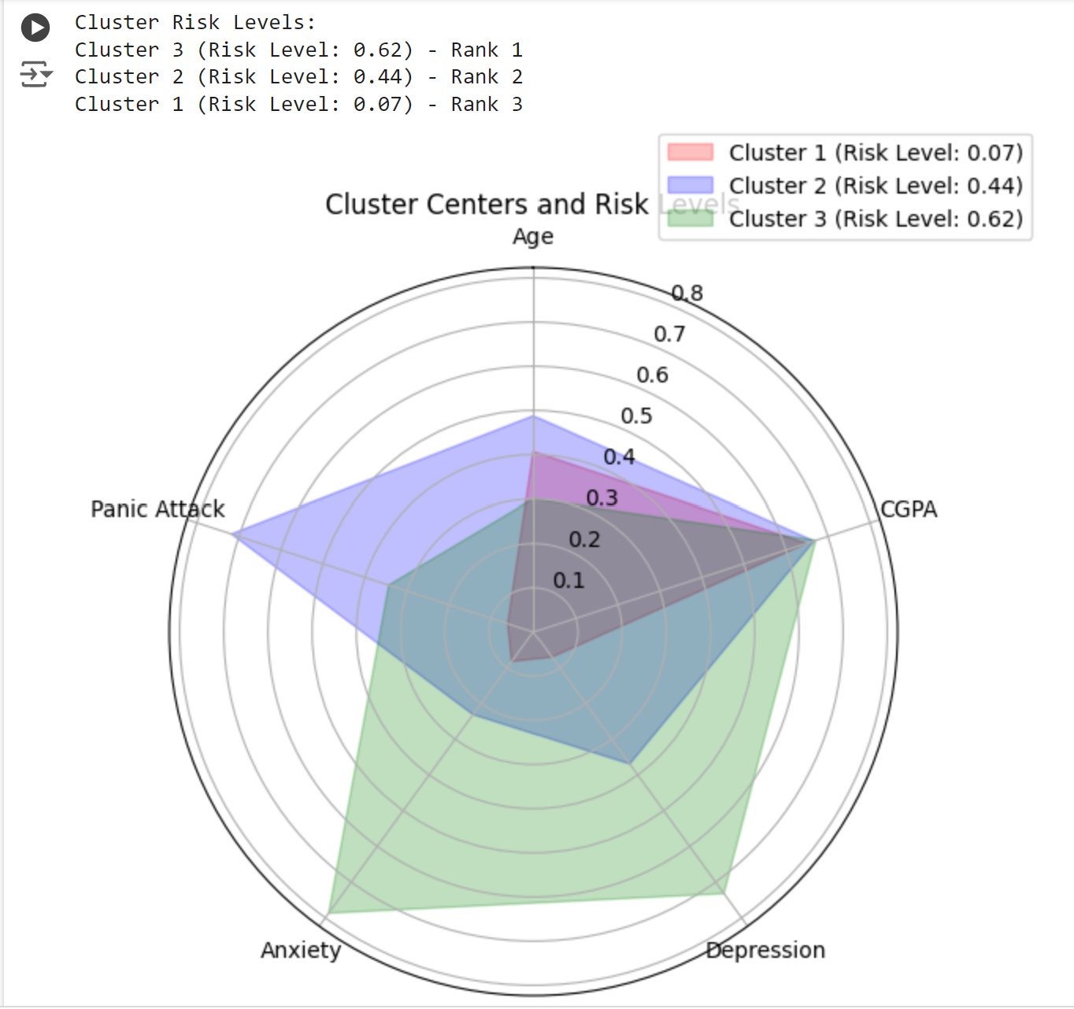
Radar chart of Clusters
OUTPUT:
Cluster Risk Levels:
Cluster 3 (Risk Level: 0.62):
Highest risk cluster (Rank 1).
Students in this cluster exhibit high levels of depression, anxiety, and panic attacks.
Actionable Insight: Students in Cluster 3 need immediate mental health support and counseling.
Cluster 2 (Risk Level: 0.44):
Moderate risk cluster (Rank 2).
Students in this cluster show moderate levels of mental health challenges, but their risk is not as severe as Cluster 3.
Actionable Insight: Preventive measures, such as workshops and stress management resources, can help this group.
Cluster 1 (Risk Level: 0.07):
Lowest risk cluster (Rank 3).
Students in this cluster display very low levels of depression, anxiety, and panic attacks.
Actionable Insight: These students appear resilient, but periodic check-ins are advisable to maintain their well-being.

Slide 15
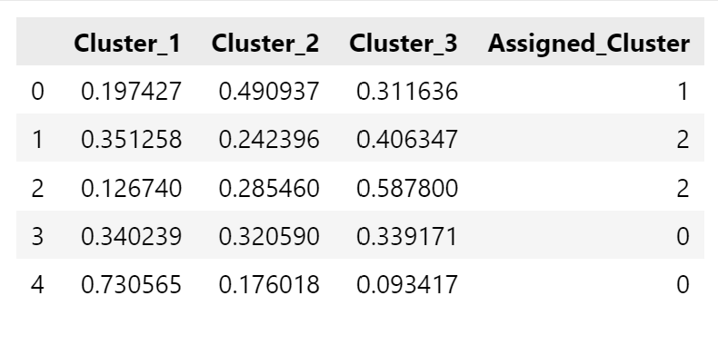
Cluster Membership Score of first 5 entries
OUTPUT:

Slide 16
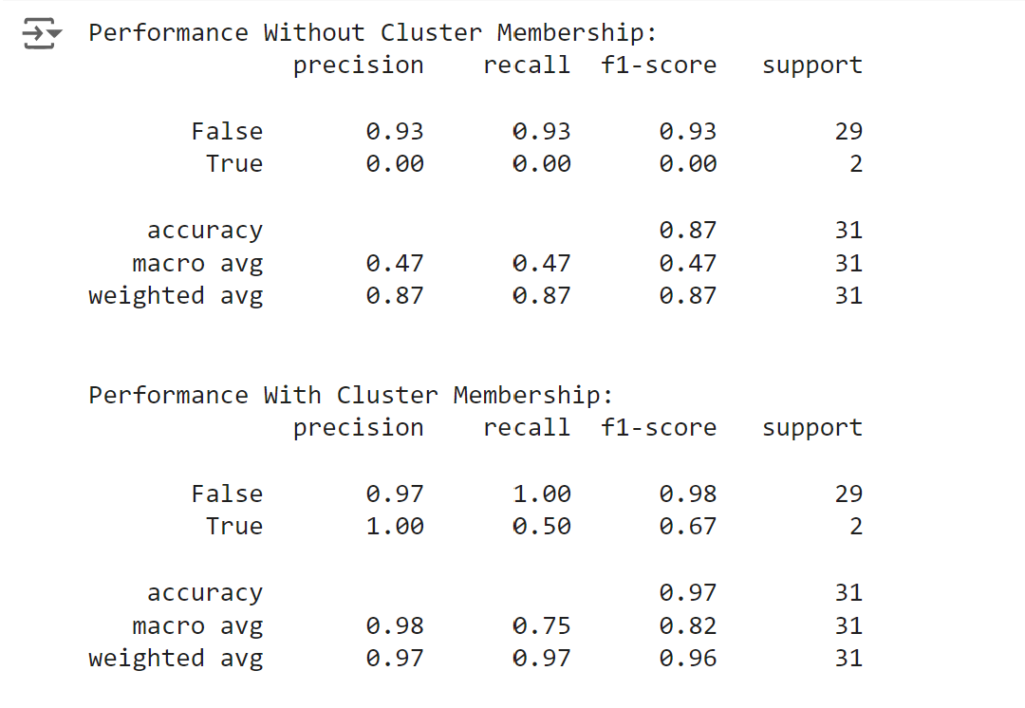
Performance With/Without Cluster Membership
OUTPUT:

Slide 17
05
Challenges & Future Scope

Slide 18
Challenges
Cluster Interpretation
Limited dataset features
Class Imbalance
Fewer students reported seeking specialist treatment, affecting the KNN model's ability to generalize.
The dataset includes a limited number of features, which restricts the model's ability to capture more nuanced aspects of mental health (e.g., stress levels, external pressures, or social support).
Differentiating clusters with overlapping characteristics required careful analysis of membership values.

Slide 19
Future Scopes
Model Enhancements:
Implement Weighted KNN to improve predictions for imbalanced datasets.
Explore other clustering techniques (e.g., DBSCAN or Hierarchical Clustering) for comparative analysis.
Integration with Institutional Systems:
Use the model to identify at-risk students in real-time and recommend mental health interventions.
Expanded Dataset:
Include additional features like socioeconomic background, study habits, and extracurricular activities for a more holistic analysis.
Interactive Dashboard:
Develop a user-friendly interface for visualizing student clusters and risk predictions.
Predictive Interventions:
Use the model's predictions to proactively reach out to high-risk students and provide them with counseling resources.

Slide 20
06
Conclusions

Slide 21
Why Choose "Seeking Specialist Treatment" as the Target Variable?
Mental health issues among students often go untreated despite being prevalent.
The project identifies factors driving students to seek help and barriers preventing others, aiding in designing targeted mental health awareness programs.
Actionable Insights for Stakeholders
Helps universities and counselors identify at-risk students and allocate mental health resources effectively.
Highlights groups (e.g., high-anxiety, low-CGPA students) requiring focused interventions.
Use of Clustering
Fuzzy C-Means clustering groups students into distinct mental health profiles.
Cluster memberships enrich the classification model by adding a new dimension for predicting help-seeking behavior.
Impact of Prediction
Identifies patterns in students not seeking treatment despite having mental health issues.
Highlights disparities influenced by factors like age, gender, or academic performance..
Final Vision
Empowers institutions to recognize mental health patterns, proactively intervene, and reduce barriers to treatment.

Slide 22
Thank You!
Do you have any questions?

